Slide 1
Virtual Memory

Slide 2
Objectives
To describe the benefits of a virtual memory system
To explain the concepts of demand paging and page-replacement algorithms

Slide 3
Virtual Memory
Virtual memory is the dominant strategy in modern OSs
Have seen virtual memory in Windows 7
It uses a page file
By default, the size of virtual memory is equal to the amount of physical RAM
Notes:
Virtual memory uses a type of swapping.

Slide 4
Background
Up to now a process resides entirely in memory while executing
Virtual memory – separation of user logical memory from physical memory.
  Only part of the program needs to be in memory for execution
  Logical address space can therefore be much larger than physical address space
  A program that takes more space than the memory size can be executed

Slide 5
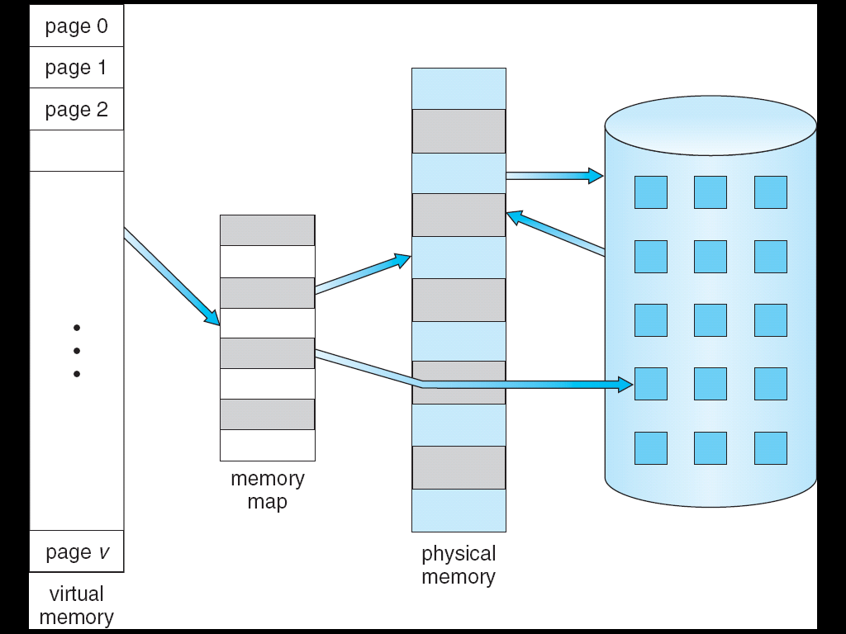
Virtual Memory That is Larger Than Physical Memory
⇒

Slide 6
Virtual memory can be implemented using demand paging:
  Initially all pages of a program are in secondary storage
  Bring a page into memory only when it is needed
    If there are no free page frames in memory to hold this page, OS must select one page for removal
Note: a process that’s executing must have the page, containing the currently executing instructions, in memory

Slide 7
Page-fault occurs when a page, that is not in RAM, needs to be accessed
If there are no free page frames in memory to hold this page
  OS uses page replacement algorithm to choose one page for removal
  find some page in memory, but not really in use, swap it out
  performance – want an algorithm which will result in minimum number of page faults
Same page may be brought into memory several times

Slide 8
Thrashing
Thrashing occurs if RAM is too small to hold the all the processes running.
  A process is thrashing if more time is spent bringing its pages into memory (by swapping with other pages in memory) than executing

